Slide 1
Drug Extraction Toolbox
Nick Anthony
Data Engineer - University of Kentucky - College of Pharmacy
Twitter: @nanthony95
GitHub: @nanthony007
GitHub: https://github.com/UK-IPOP
Email: nicholas.anthony@uky.edu

Slide 2

A little about me…
I build data-driven OSS software
Started in analytics
Dabbled in web frontend
Appreciate speed and simplicity
Love my doggo

Slide 3
Let’s talk drugs

Slide 4
Data Exploration
Chicago Medical Examiner’s Case Archive
Open Data provided by Cook County
Contains lots of useful death information for pharmaceutical and public health researchers
Primary Cause of Death (field)
Ex 1: “NOVEL CORONA (COVID-19) VIRAL INFECTION”
Ex 2: “COMBINED DRUG (COCAINE, FENTANYL, HEROIN, CLONAZEPAM
Researchers want to know a unique list of drugs to monitor opioid crisis
Researcher has specific drug list of interest
What do we do?

Slide 5
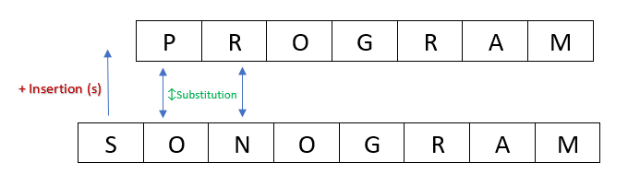
First attempts
String matching using grep (R)
Introduce known misspellings
Have to manually insert drugs
Exact string matching (Python)
A little faster
More tedious development
Implemented “drug_search” file
String similarity searching (Python)
SLOW
~0.67
Notes:
Grep search in R
Not portable (r, rstudio, etc)
Slow slow slow
Error prone,
Manual
Around this time we were building the regex model using JaroWinkler string similarity calculation.
For those of you who don’t know, SS is how close one string is to another, usually measured in a ratio of 0-1, 1 being a perfect match.
HOURS to search
** TOO LONG **

Slide 6
There must be a better way…

Slide 7
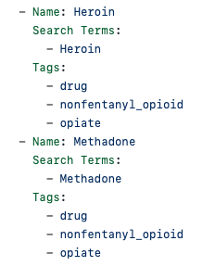
Go to the rescue
Go benefits:
Type safety
Compiled
Concurrency (goroutines)
Speed
Easy to learn
Brilliant idea!
Go CLI tool with web interface
Improved custom “drug_search” file
Improved performance
Notes:
Go provided improved performance from ~2 hours down to a few minutes.
Drug Info file expanded to include tags.

Slide 8
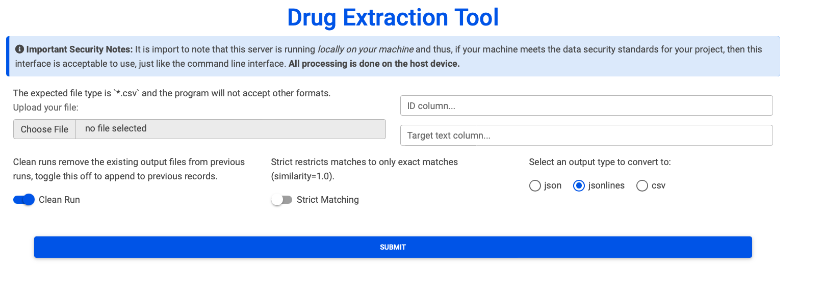
Drug Extraction Tool
Cobra CLI
Server command for web UI
Available by click to install and run
Cross platform (thank you goreleaser)
STILL available
Notes:
Server command is default
Available on go-tool branch

Slide 9
But can we do better?
Notes:
Well sure…
It could always be faster…
What if we didn’t use a custom file for one researcher’s needs but made a flexible search system to serve many researchers
-> That is going to need a nice UI
-> Install process was easy but not straightforward, usage involved running a weird looking exe app…
-> Better output
->PHI compliance
What about searching beyond uni-grams?

Slide 10

Is it worth it?

Slide 11

R&D

Slide 12
Benchmark Testing
Languages
Python
Go
Rust
Interfaces
CLI
Web
Packages
Metrics
JaroWinkler
Levenshtein (Damerau)
Would the benefits of another language system outweigh the costs of development and maintenance?
Notes:
Available on perf-comp branch on github.
Rules:
External dependencies allowed, we don’t care about artifact size.
Fast, but reasonable development time.
Same implementation, different language.
No “speed” libraries (i.e. python libraries relying on C)
MUST use external libs for algorithm implementation
Must be compared using same drug list.
Must use same search list (50k records from Chicago ME)
… technically jarowinkler isn’t a metric (doesn’t obey triangle inequality)

Slide 13
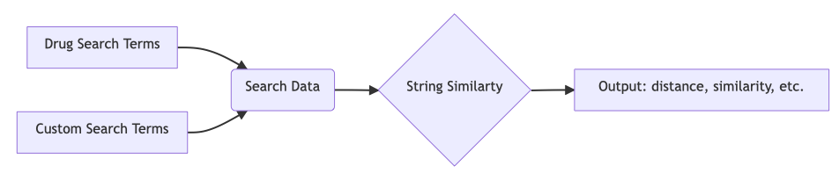
Standard Program Flow
Notes:
If you’d like to see more details about inputs and outputs feel free to reach out to me after the talk
** Detail? **

Slide 14
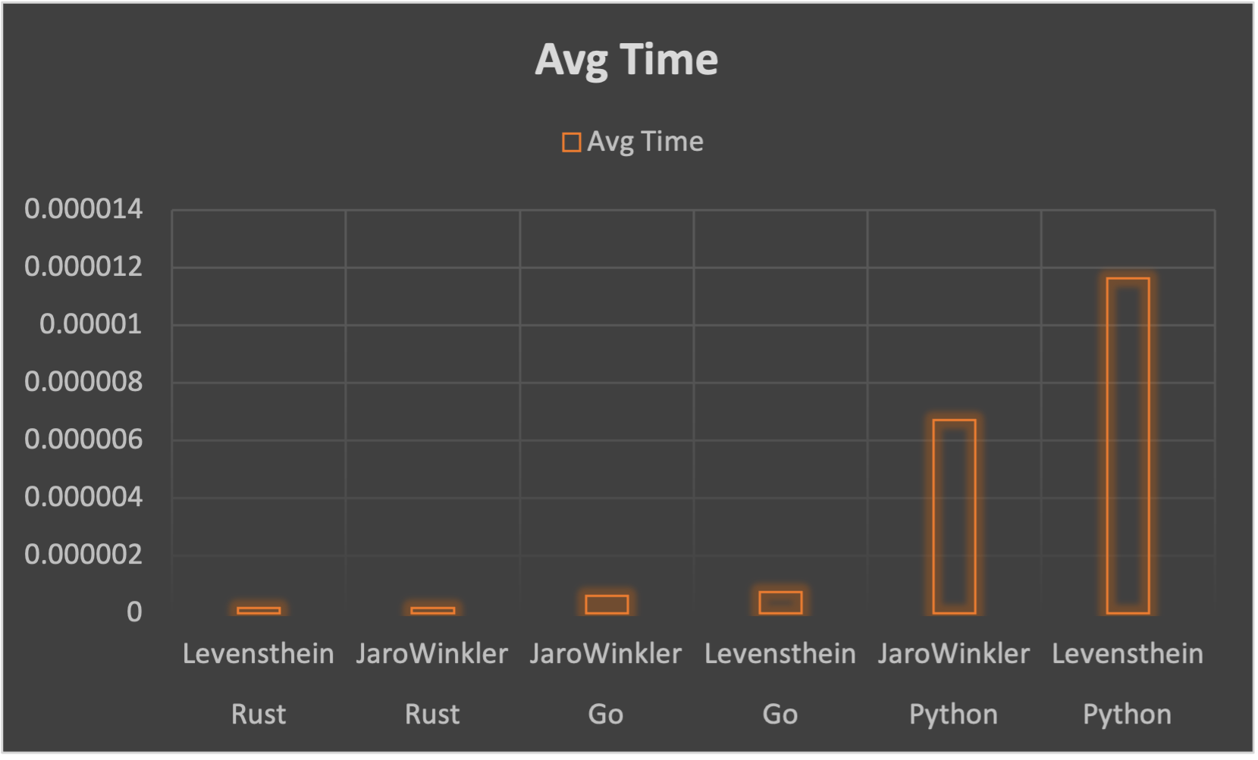
Results
Python
~150 lines
Go
~270 lines
Rust
~260 lines
Notes:
Programs did minimal preprocessing other than casing and removal of punctuation.
145_572_952 iterations.
~145 million on only 50k records…
Iterations are number of times algorithm run (effectively number of word comparisons).
Line count includes comments, imports, blank lines, etc. etc.
Time here is only algorithm runtime, nothing else.
*** Why are these different? ***

Slide 15
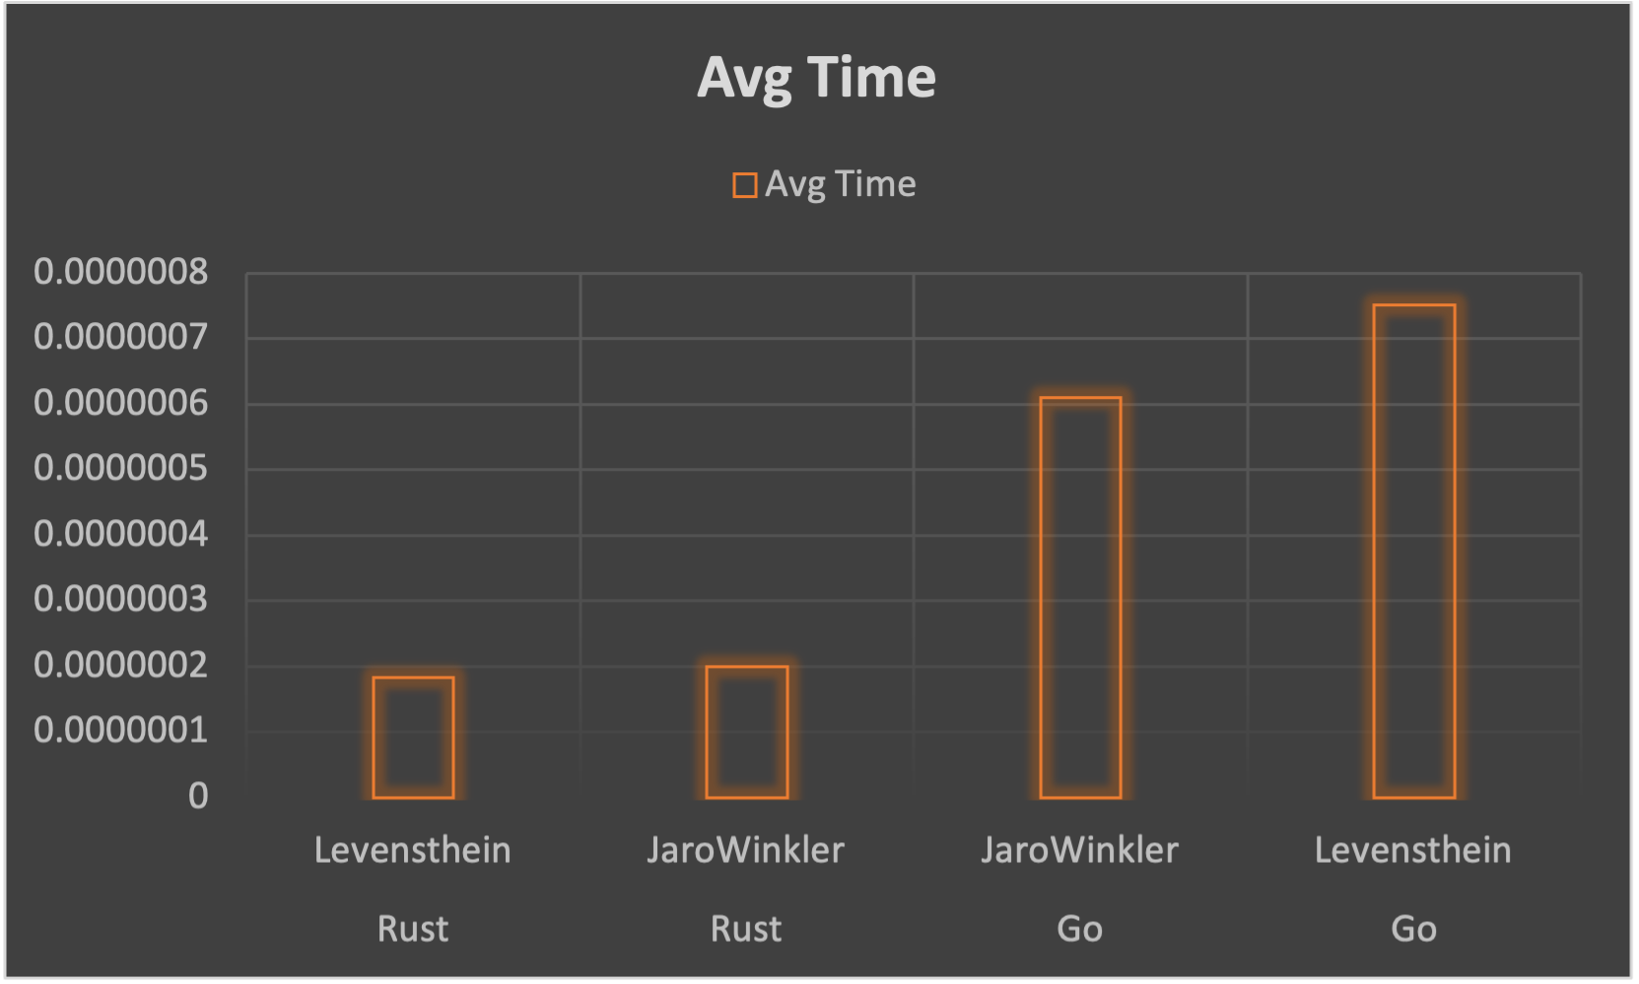
Sorry Python…

Slide 16
So RUST, right?

Slide 17
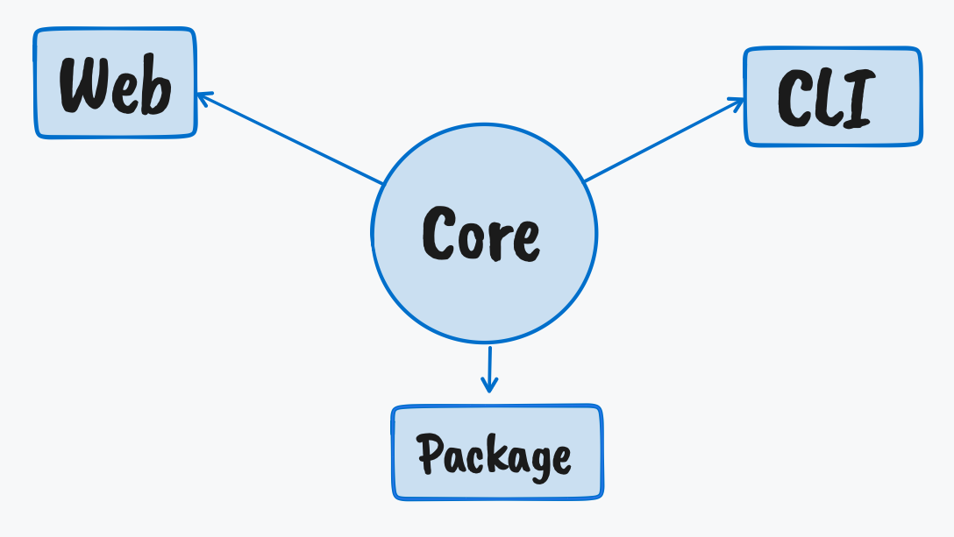
Toolbox Ecosystem
Notes:
Web App enabled via Web Assembly (wasm) = native rust performance in the browser
CLI enabled via clap crate
WASM npm package
Cargo crate for CLI (cargo install)
Core crate library for devs will be the standard program from testing

Slide 18


Toolbox Architecture
Notes:
Rust
NextJS
WebAssembly

Slide 19
Building the future
Key Features:
Link to RxNorm in customizable way
Improved output
*.csv
Links to RxNorm IDs
Link to record ID
Custom search option (ignores RxNorm)
Key Hurdles (opportunities):
Data security of a website
CLI tool on secure server
What about non-technical users?
Concurrency
Performance tweaks
Notes:
Utilize RxNorm / RxClass API to extract drugs of a specific class
-> This could be more verbose/customizable/intuitive in the web interface whereas the CLI just takes the classID

Slide 20

Acknowledgements
Google
Rust maintainers
Chris Delcher
Daniel Harris
My wife
Notes:
Google for their search engine. (stack overflow)
Rust maintainers for their amazing language and documentation.
Chris for having a need for such a useful tool. (if I ever make anything cool that you use or like, it’s probably because he needed it for something)
Daniel for providing technical guidance and wisdom.
My wife for patience when I’m smashing my head against the Rust compiler.

Slide 21

Questions?
Notes:
My notes:
Ideally come back to this in a few months and have the tools built out
Docker image for desktop use
More architecture details (data / software flow chart)
Also have more improved flowchart of UX
Samples of code
Live website run through
Live coding?
Validate methods via ensuring the same output
How to sell a tool as dev…
Share with some company like Socrata as an implementation
Felt like a product pitch (that’s what normally happens when presenting a new tool at conferences)
My questions:
Feedback on presentation?
Feedback on toolbox ideas?
Tried to balance technical and non-technical aspects
What would make you confident in using this tool?

